Slide 1
SESSION 3
Goal: build intuition for predicting continuous outcomes and judging model error.
Regression Fundamentals
Linear models • Polynomial terms • Regularization • Residuals • Regression metrics
Session focus
• Regression problem framing
• Baselines and model fit
• Linear vs. nonlinear terms
• Regularization
• Residuals and metrics
Applied AI Design Workshop for Faculty
Fred Livingston (fjliving@ncsu.edu) 2026
1

Slide 2
APPLIED AI DESIGN WORKSHOP
Session 3
Session 3
From engineering problem to ML problem
Earlier
Problem framing
Task choice
Classic ML overview
Invited presentation: From Prompts to Agents
Break
Regression fundamentals
Now
Classification fundamentals
Next
Hands-on baseline model activity
Practice
2

Slide 3
APPLIED AI DESIGN WORKSHOP
Session 3
Session 3 learning outcomes
Define
Recognize when a continuous target makes regression appropriate
Model
Explain linear, polynomial, and regularized regression at a conceptual level
Evaluate
Compare model performance to a simple baseline using common metrics
Diagnose
Use residuals to identify bias, outliers, nonlinearity, or heteroscedasticity
Discuss
Decide when more complex models are justified for disciplinary use
Participant output: a regression problem statement, a baseline choice, an initial metric, and one diagnostic question about model error.
3

Slide 4
APPLIED AI DESIGN WORKSHOP
Session 3
What makes a problem a regression problem?
Regression predicts a continuous numerical outcome. The model is judged by how far predictions are from observed values.
Use regression when asking:
• How much?
• How many?
• What value?
• What final measurement?
• What future quantity?
Typical targets:
• Strength
• Energy use
• Cycle time
• Yield
• Temperature
• Score
• Remaining life
Not regression when:
• Target is a class label
• Goal is discovering groups
• Output is open-ended text
• The main goal is causal proof
Key discipline question: What error magnitude is acceptable for this application?
4

Slide 5
APPLIED AI DESIGN WORKSHOP
Session 3
Activity: write a regression problem statement
Use the template to convert a disciplinary problem into a regression task.
Using __________ as inputs, develop a regression model to predict __________ for each __________, with performance evaluated using __________.
Inputs
Variables available before prediction
Target
Continuous outcome to predict
Unit
Run, sample, student, machine cycle, patient, day
Metric
MAE, RMSE, R², or domain threshold
Quick check: are all input variables available at the time the prediction must be made?
5

Slide 6
APPLIED AI DESIGN WORKSHOP
Session 3
Example: predicting material strength
A regression dataset pairs process and material conditions with a continuous measured outcome.
Run
Temp
Pressure
Time
Cooling
Strength
Prediction objective
Estimate final strength before destructive testing.
1
185
42
28
Slow
72.4
2
190
45
30
Fast
75.8
3
175
39
24
Slow
65.1
Baseline
Predict the mean training-set strength for every run.
4
205
47
35
Fast
82.6
5
198
44
31
Slow
79.3
Metric
Use MAE when errors are easy to interpret in original units.
6

Slide 7
APPLIED AI DESIGN WORKSHOP
Session 3
Start with a baseline before training a model
A baseline is the simplest prediction that a machine learning model must improve upon.
Mean baseline
Predict the average training target for every new case.
Useful when squared error or RMSE is central.
Median baseline
Predict the median training target for every new case.
Useful when outliers may distort the mean.
Domain baseline
Compare to current practice, heuristic, lookup table, or physics estimate.
Often the most persuasive baseline.
Discussion prompt: Is “better than the mean” enough, or must the model beat current disciplinary practice?
7

Slide 8
APPLIED AI DESIGN WORKSHOP
Session 3
Linear regression: a first interpretable model
Linear regression estimates how the target changes with input features, assuming an approximately linear relationship.
Model form
ŷ = β₀ + β₁x₁ + β₂x₂ + ... + βₚxₚ
Target
Interpretation
A coefficient estimates average target change when one feature changes, holding others constant.
Caution
Interpretation depends on data quality, feature scaling, correlation, and study design.
Feature value
8

Slide 9
APPLIED AI DESIGN WORKSHOP
Session 3
Linear regression: a first interpretable model
In ML, we write the equation for a linear regression model as follows:
y′=b+w1x1
where:
y′ is the predicted label—the output.
b is the bias of the model. Bias is the same concept as the y-intercept in the algebraic equation for a line. In ML, bias is sometimes referred to as w0. Bias is a parameter of the model and is calculated during training.
w1 is the weight of the feature. Weight is the same concept as the slope m in the algebraic equation for a line. Weight is a parameter of the model and is calculated during training.
x1 is a feature—the input.
8

Slide 10
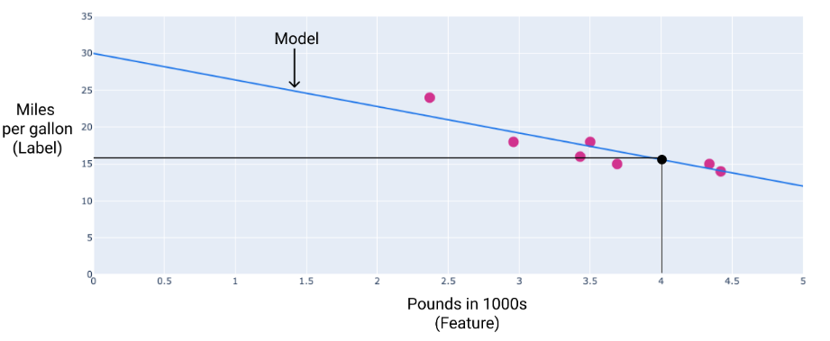
APPLIED AI DESIGN WORKSHOP
Session 3
Linear regression: Training Model
In our example, we'd calculate the weight and bias from the line we drew. The bias is 30 (where the line intersects the y-axis), and the weight is -3.6 (the slope of the line). The model would be defined as y’=30 + (-3.6)(x1), and we could use it to make predictions. For instance, using this model, a 4,000-pound car would have a predicted fuel efficiency of 15.6 miles per gallon.
Using the model, a 4,000-pound car has a predicted fuel efficiency of 15.6 miles per gallon.
8

Slide 11
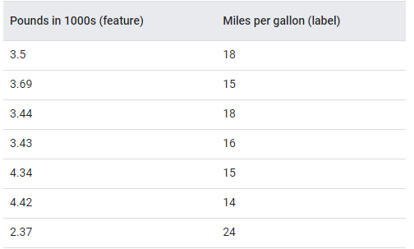
APPLIED AI DESIGN WORKSHOP
Session 3
Linear regression: a first interpretable model
1. Define training set
2. Initialize model weights and bias to zero
b := 0
x₁
Make Prediction
w := 0
1
Weighted sum
Z=y’
w := 0
x
2
2
8

Slide 12
APPLIED AI DESIGN WORKSHOP
Session 3
Linear regression: a first interpretable model
Model parameters to compute value
x₁
× w₁ × w₂
+ +
x₂
b
= z = y’
x₁ × w₁ + x₂ × w₂ + . . . + x_{m} × w_{m} + b = z = y’
8

Slide 13
APPLIED AI DESIGN WORKSHOP
Session 3
Linear regression: a first interpretable model
What is the model first prediction
b := 0
x₁
Make Prediction
w := 0
1
Weighted sum
Z=y’
w := 0
x
2
2
8

Slide 14
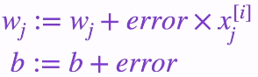


APPLIED AI DESIGN WORKSHOP
Session 3
Linear regression: a first interpretable model
Update the weights based on the error
For where x1 = 3.5, and b = 0, and Error is 18
18
b := 0
x₁
63
w₁ := 0
z
.
Make Prediction
Compute
value
8

Slide 15






APPLIED AI DESIGN WORKSHOP
Session 3
Linear regression: a first interpretable model
Computation Graph of System
Suppose the true output is 1
y = 1
b
w₁
x
×
u = w₁ × x₁
+
z = u + b
l = L(z, y)
1
8

Slide 16
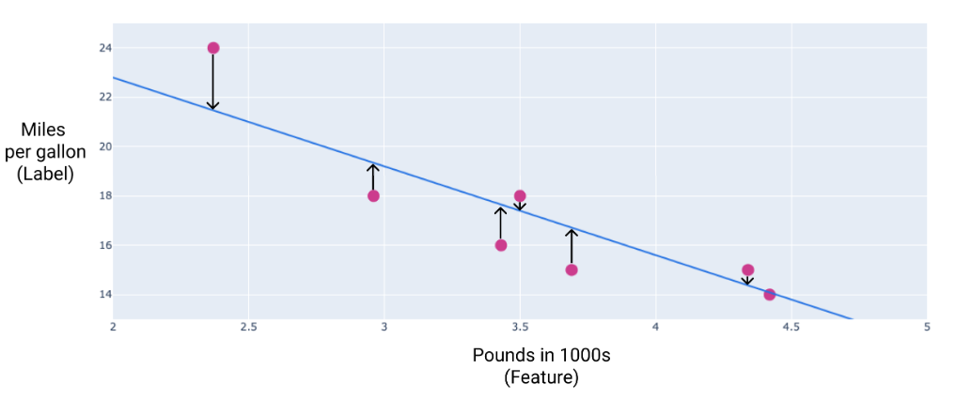
APPLIED AI DESIGN WORKSHOP
Session 3
Linear regression: a first interpretable model
Loss is a numerical metric that describes how wrong a model's predictions are. Loss measures the distance between the model's predictions and the actual labels. The goal of training a model is to minimize the loss, reducing it to its lowest possible value.
The arrows show how far the model's predictions are from the actual values.
8
16

Slide 17
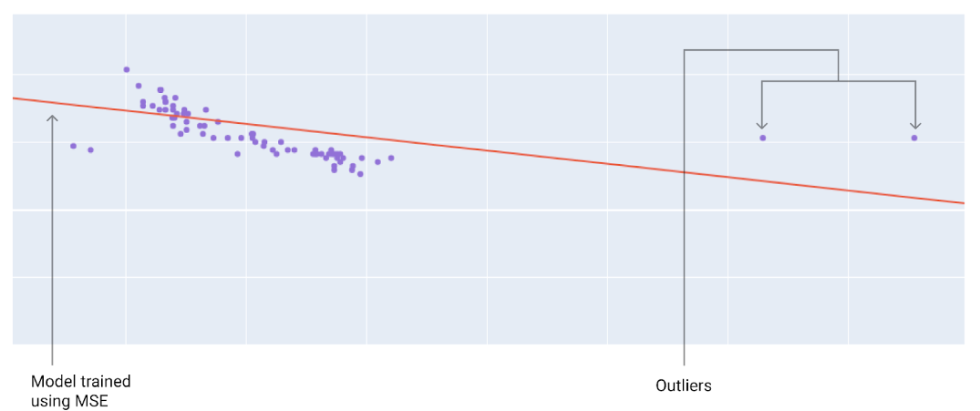
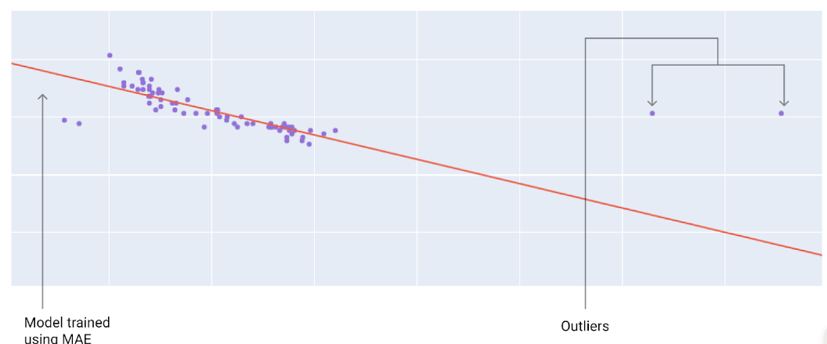
APPLIED AI DESIGN WORKSHOP
Session 3
Linear regression: a first interpretable model
8

Slide 18
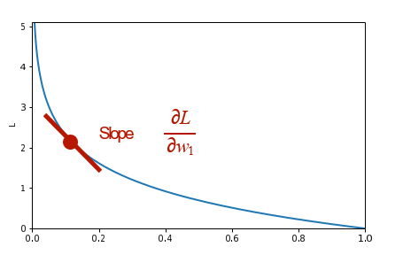
APPLIED AI DESIGN WORKSHOP
Session 3
Linear regression: a first interpretable model
18
b := 0
x₁
63
w₁ := 0
z
.
Make Prediction
Compute
value
Update the weights based on slope of Loss Function
8

Slide 19

APPLIED AI DESIGN WORKSHOP
Session 3
Linear regression: a first interpretable model
Minimizing the Loss Using Gradient Descent
y
b
x₁
w
×
u = w₁ × x₁
+
z = u + b
l = L(a, y)
1
∂L ∂u ∂z dL
= × ×
∂L
∂w
∂w₁ ∂w₁
∂u dz
∂z × dL
∂b dz
∇L =
1
∂L
∂b
∂L
=
∂b
8

Slide 20
APPLIED AI DESIGN WORKSHOP
Session 3
Polynomial terms: capturing simple nonlinearity
Polynomial regression still uses linear regression machinery, but adds transformed features such as x².
Example model
ŷ = β₀ + β₁x + β₂x²
When useful
Residuals show curved patterns, but the underlying relationship remains smooth and low-dimensional.
Risk
High-degree polynomials can chase noise and perform poorly on new data.
9

Slide 21
APPLIED AI DESIGN WORKSHOP
Session 3
Regularization: controlling overly flexible models
Regularization adds a penalty for large coefficients to reduce overfitting and improve generalization.
Ridge regression
Shrinks coefficients toward zero.
Useful when many correlated features are present.
Lasso regression
Can shrink some coefficients exactly to zero.
Useful for feature selection and simpler models.
Tradeoff
Slightly more bias may reduce variance.
The goal is lower error on new data, not perfect fit to training data.
When would a smaller, more stable model be preferable to a slightly more accurate model?
10

Slide 22
APPLIED AI DESIGN WORKSHOP
Session 3
Regression metrics: measure error in different ways
No single metric is universally best. Choose the metric based on the meaning and cost of prediction errors.
MAE
Average absolute error
Easy to interpret in target units
RMSE
Square root of average squared error
Penalizes large errors more strongly
R²
Fraction of variance explained relative to baseline
Useful summary but can hide large errors
Domain threshold
Percent of predictions within an acceptable error band
Often most meaningful to stakeholders
Metric choice is an ethical and practical design choice: it determines which errors the model prioritizes.
11

Slide 23
APPLIED AI DESIGN WORKSHOP
Session 3
Residuals: where the model is wrong
A residual is observed value minus predicted value. Residual plots reveal patterns that a single metric can hide.
Look for patterns
• Centered around zero
• Curved pattern → missing nonlinearity
Residual
• Fan shape → changing variance
• Large isolated points → possible outliers
• Groups of errors → missing feature or population shift
Predicted value
12

Slide 24
APPLIED AI DESIGN WORKSHOP
Session 3
Activity: compare candidate regression models
Use a small dataset to compare a baseline, a linear model, and a polynomial or regularized model.
1
Choose target and inputs
2
Split training and test data
3
Fit baseline model
4
Fit regression models
5
Compare metrics
6
Inspect residuals
Model A
Mean baseline
MAE = 8.7
Model B
Linear regression
MAE = 5.1
Model C
Polynomial model
MAE = 4.8
Is the small gain from Model C worth the added complexity and lower interpretability?
13

Slide 25
APPLIED AI DESIGN WORKSHOP
Session 3
Session 3 technical skill: minimal regression workflow
Goal: demonstrate split → baseline → fit → predict → evaluate for a continuous target.
from sklearn.model_selection import train_test_split
from sklearn.linear_model import LinearRegression
from sklearn.metrics import mean_absolute_error, r2_score
X = df[features]
y = df["strength_mpa"]
X_train, X_test, y_train, y_test = train_test_split(X, y, random_state=42)
baseline = np.full(len(y_test), y_train.mean())
model = LinearRegression()
model.fit(X_train, y_train)
pred = model.predict(X_test)
mae = mean_absolute_error(y_test, pred)
r2 = r2_score(y_test, pred)
Baseline answers: “How well can we do with no model?”
MAE answers: “How wrong are we in the original units?”
R² answers: “How much variance is explained relative to the mean?”
Session 3 notebook
03_session3_regression_sklearn.ipynb
15

Slide 26
APPLIED AI DESIGN WORKSHOP
Session 3
Regression interpretation: connect metrics to units
Keep the conversation grounded in the disciplinary meaning of the target variable.
Target
Material strength
Discussion questions
Target unit
MPa
• Did the model outperform the baseline?
• Is the MAE practically acceptable?
• Are inputs available before prediction?
• What variable might be missing?
Metric
Mean Absolute Error
Interpretation
Typical absolute prediction error in MPa
Baseline MAE: 18.4 MPa
Model MAE: 7.9 MPa
Question: Is 7.9 MPa useful for this application?
15

Slide 27
APPLIED AI DESIGN WORKSHOP
Session 3
Discussion prompts
When is a linear model sufficient?
What does an error of 5 units mean in the discipline?
Should the model with the highest R² always be selected?
What residual pattern would make you distrust the model?
Can regression results be interpreted as causal evidence?
What baseline represents current practice?
Discussion goal: connect numerical performance to disciplinary usefulness and limits.
15

Slide 28
APPLIED AI DESIGN WORKSHOP
Session 3
Session 3 synthesis and transition
Regression is useful when a faculty problem requires predicting a continuous outcome and evaluating the magnitude of error.
Start simple
Use a mean, median, or disciplinary baseline.
Fit carefully
Compare simple, polynomial, and regularized models.
Evaluate meaningfully
Choose metrics that match the cost of error.
Diagnose error
Residuals reveal patterns hidden by averages.
Report limits
Prediction is not the same as explanation or causation.
Next: Classification fundamentals — predicting categories and interpreting confusion matrices.
16

